Slide 1




An exploration of properties of point clouds of individual trees extracted from a larger UAV LiDAR survey
Ivan Dubrovin
Skolkovo Institute of Science and Technology
/iod-ine
July 10, 2024
IGARSS 2024, Athens
/in/mr-ivan-dubrovin/

Slide 2
The dataset you will see is freely available to download. The link will be at the end of the presentation.

Slide 3
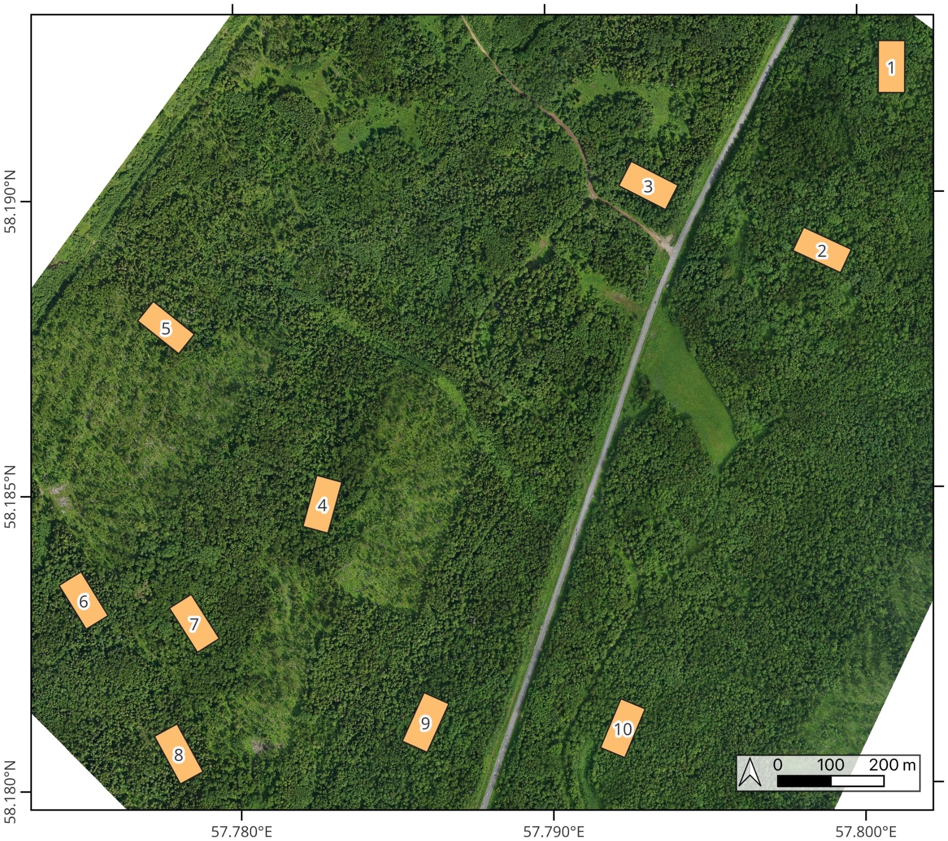
The dataset: source
This project is a part of a larger research effort into using deep learning for modeling dense mixed forests on the scale of individual trees.
The original source of the data is a large field inventory with overlapping UAV LiDAR and RGB orthophoto.
The study area is located near Perm, Russia.

Slide 4
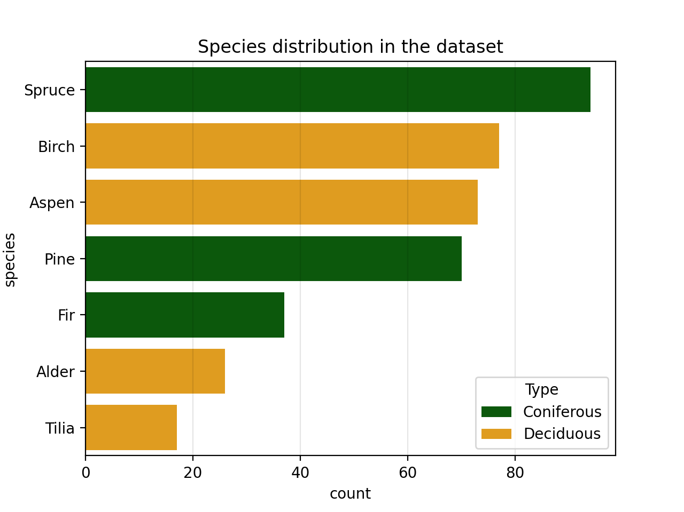
The dataset: details
394 trees, extracted by hand from a large UAV LiDAR survey.
Approximately equal number of deciduous and coniferous species.
Focus on 4 main species: spruce, birch, aspen, and pine.

Slide 5
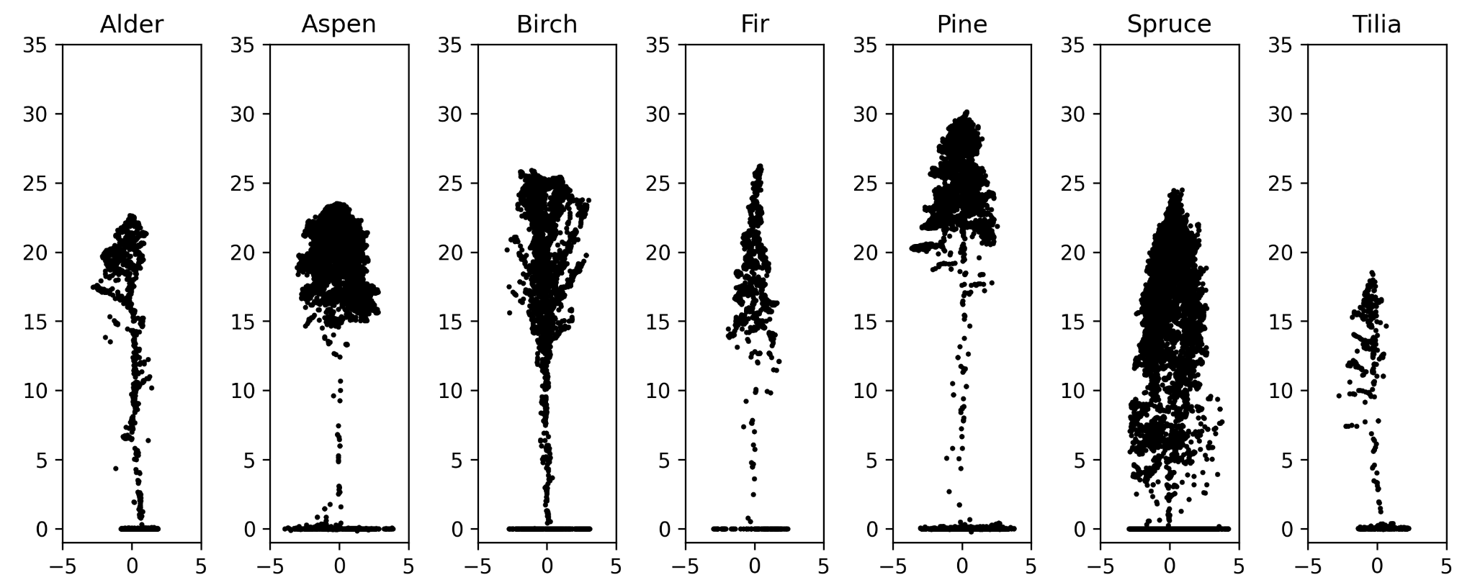
Cross-sections of individual trees

Slide 6
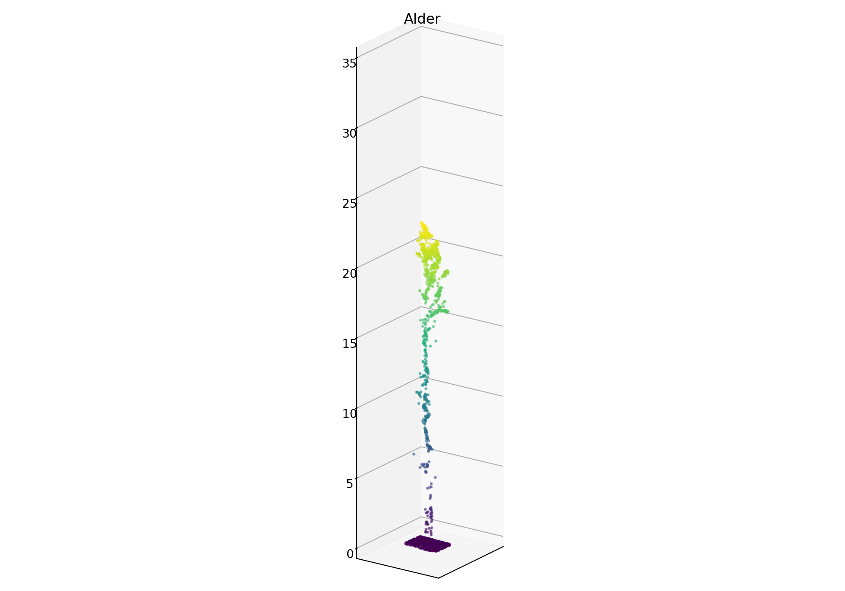
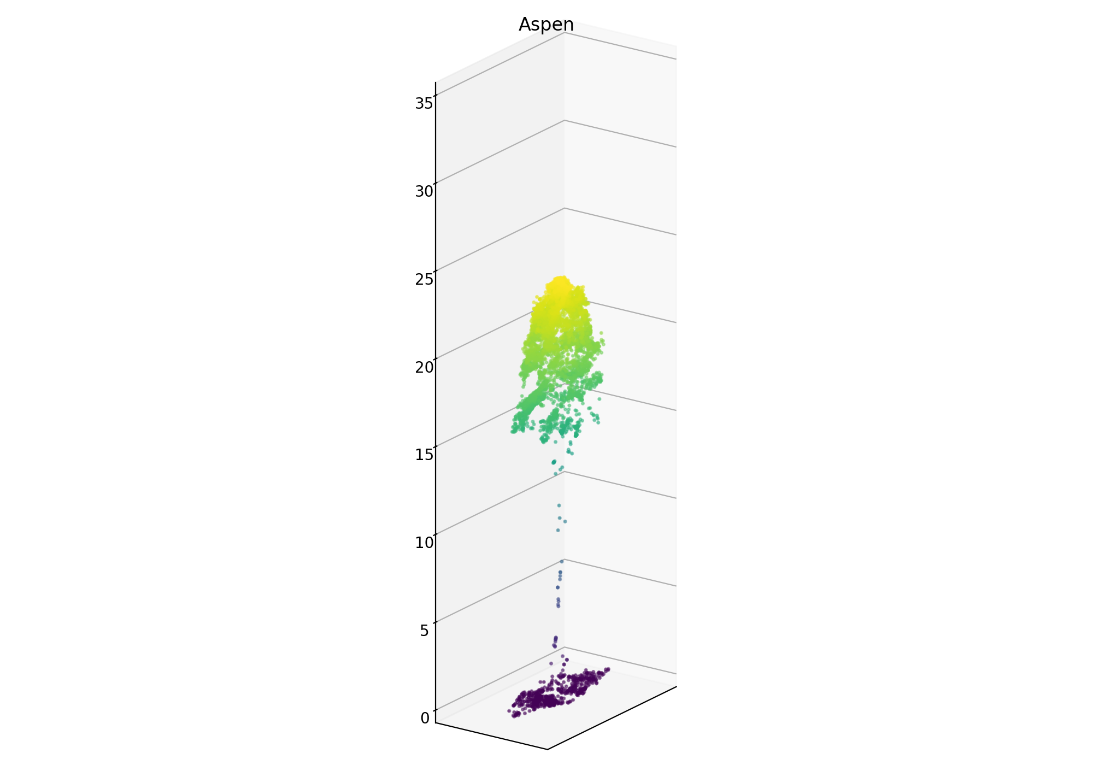
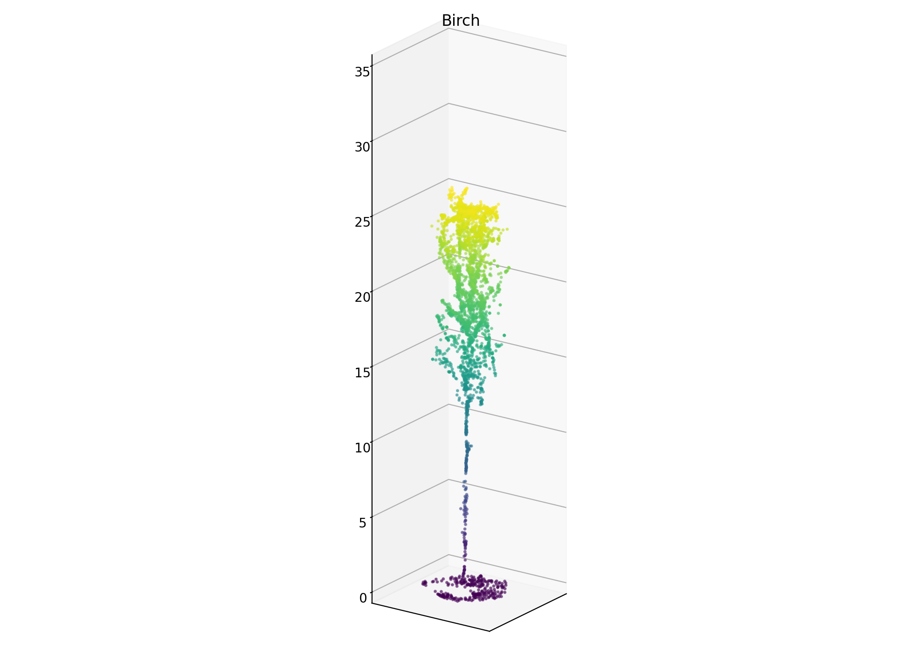
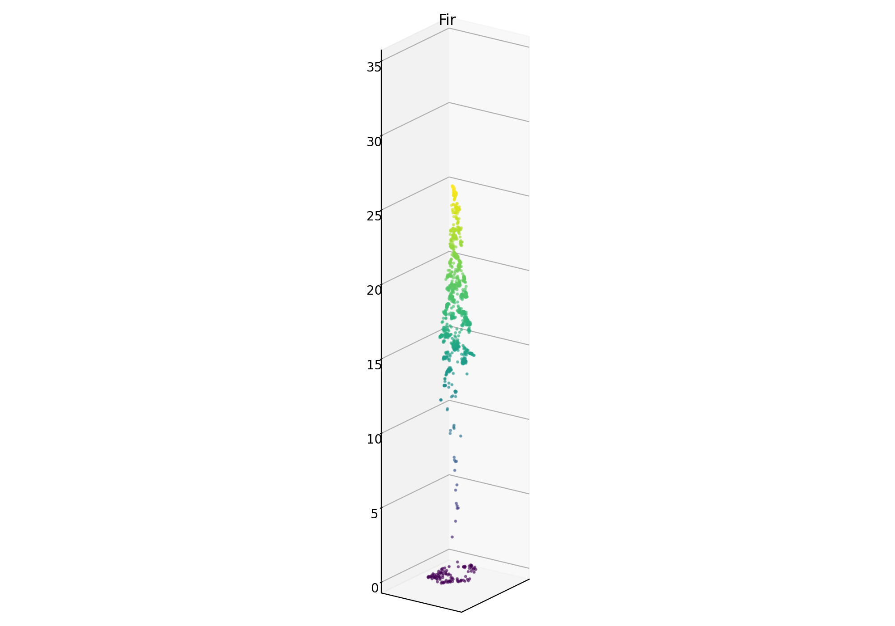
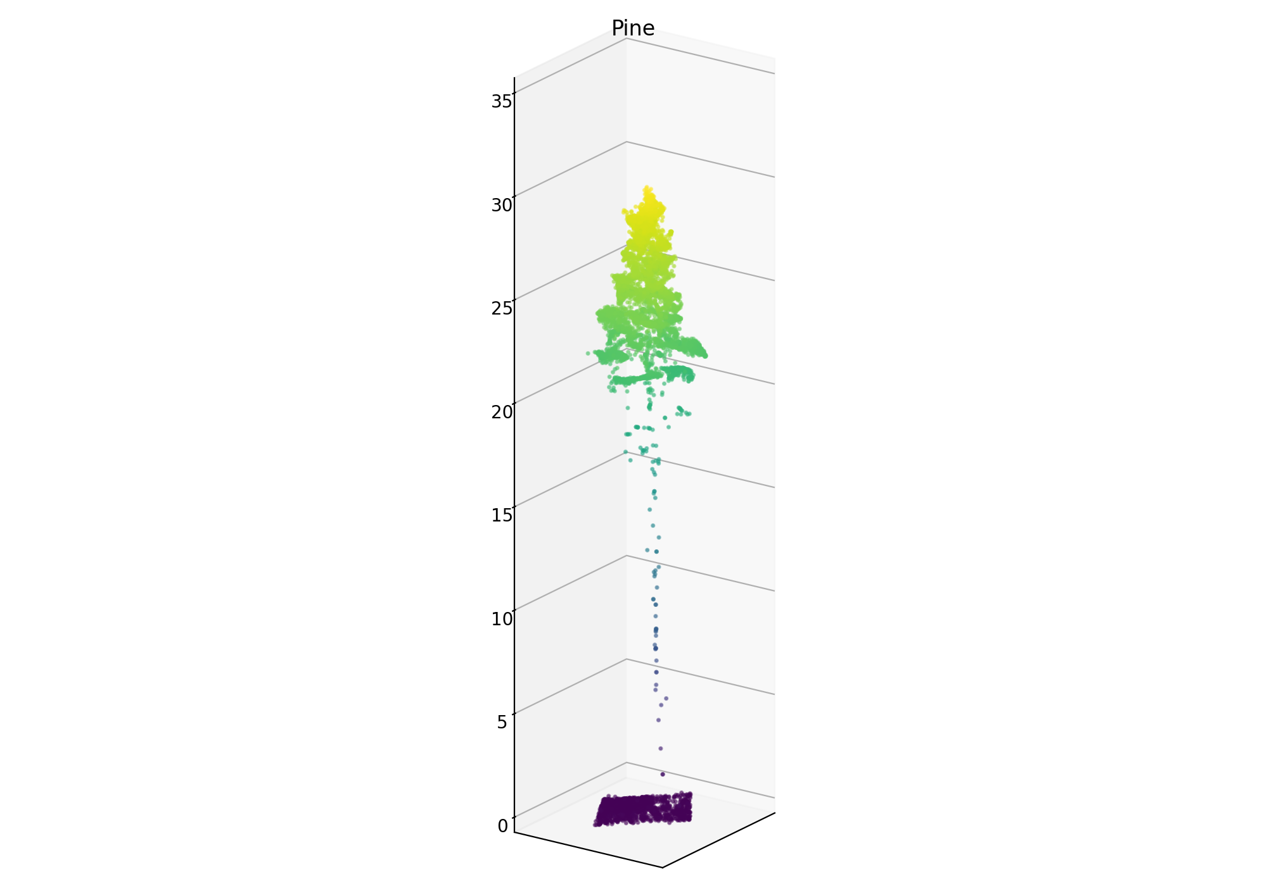
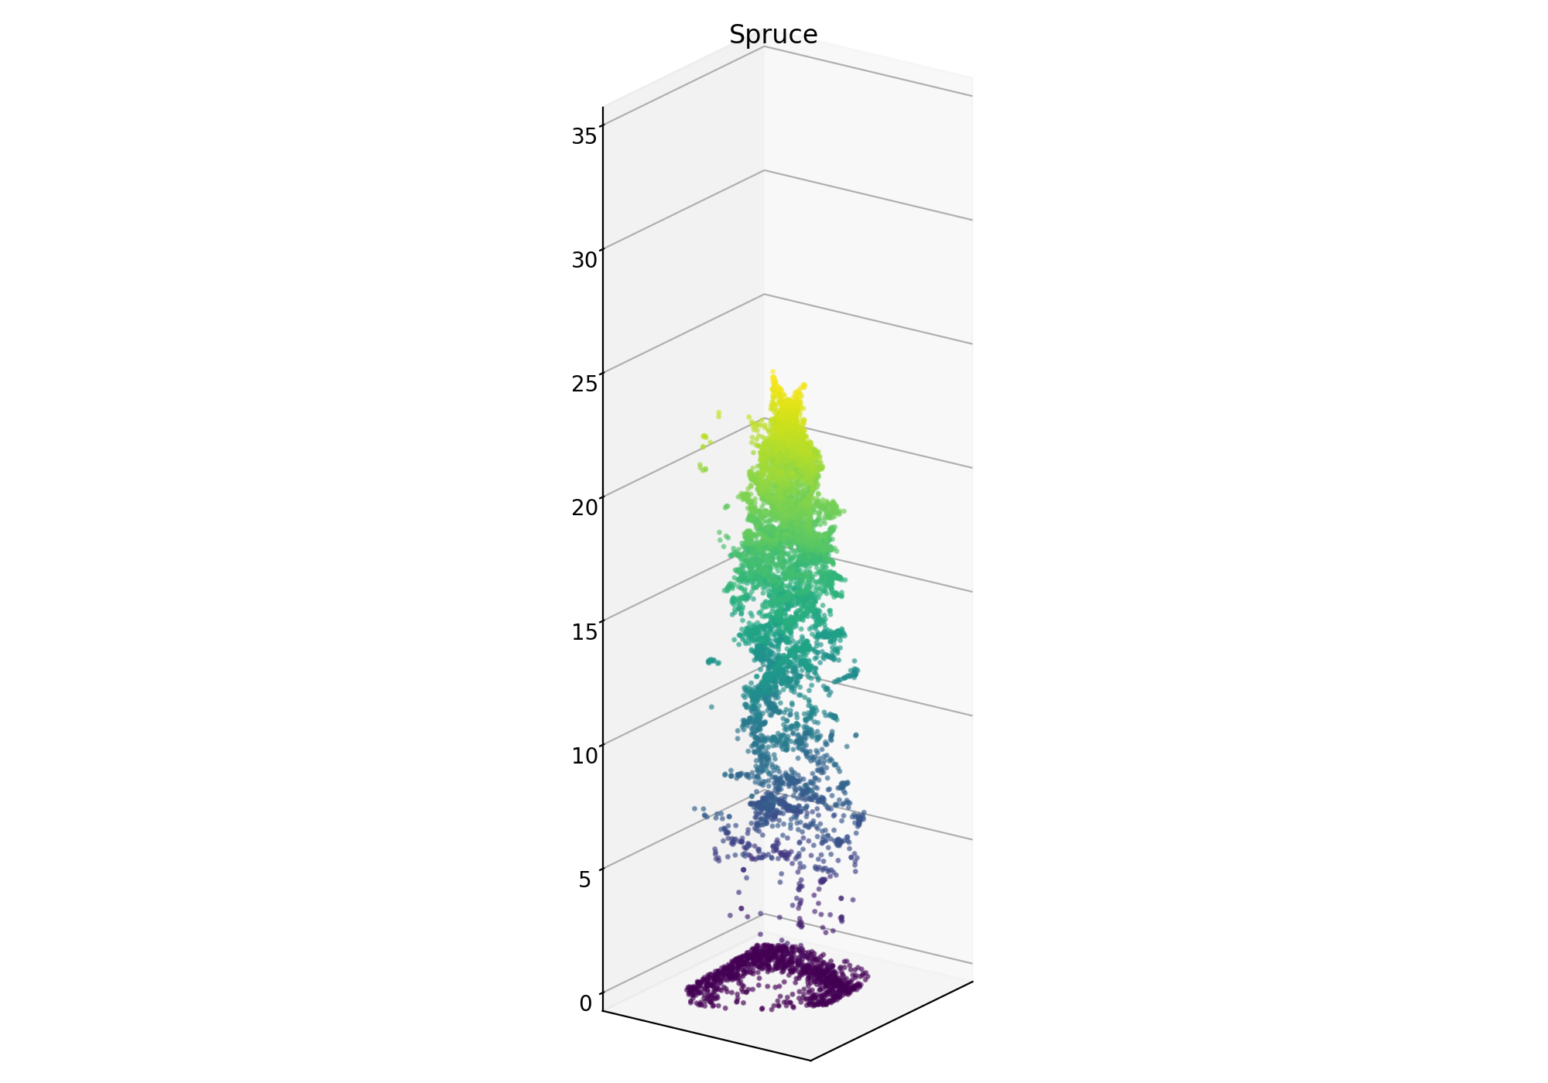
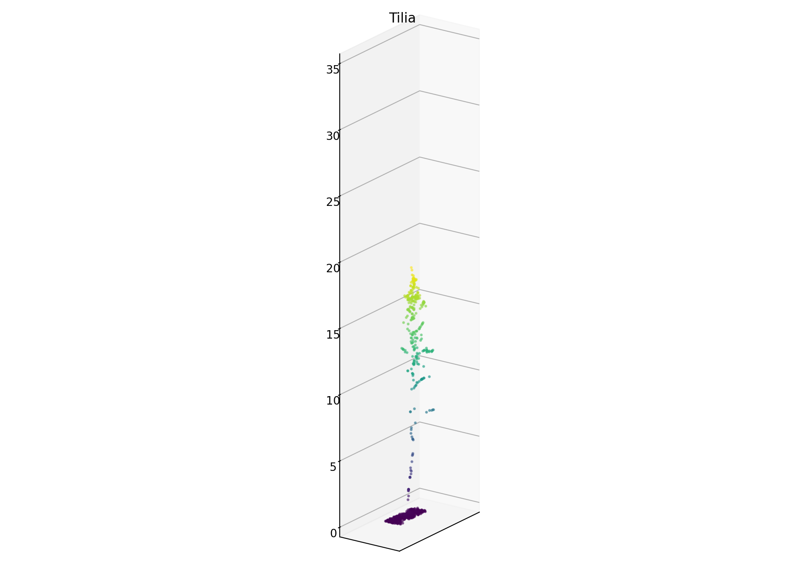
Individual trees in 3D

Slide 7
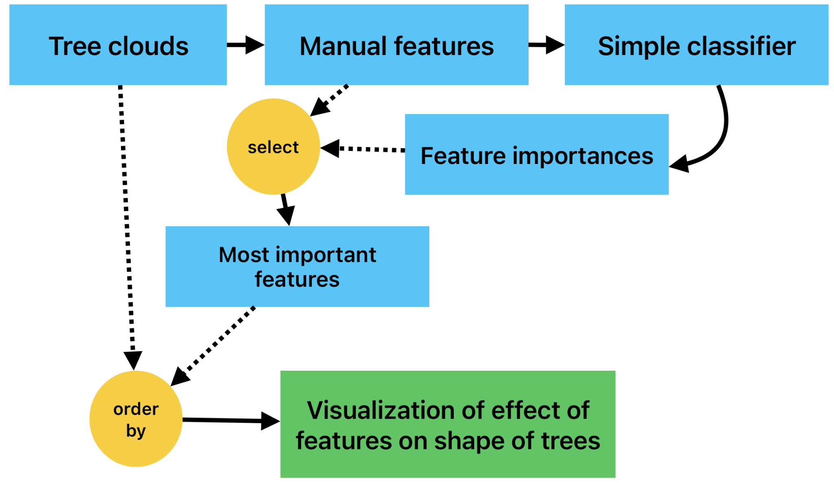
Experiment 1: Shapes of trees <-> ML feature values
Build intuition into the effect of commonly used classic machine learning features on shapes of individual trees.
Set up the problem as binary classification: classify each tree into deciduous or coniferous.
Classification is only required to make sure features have predictive power.

Slide 8
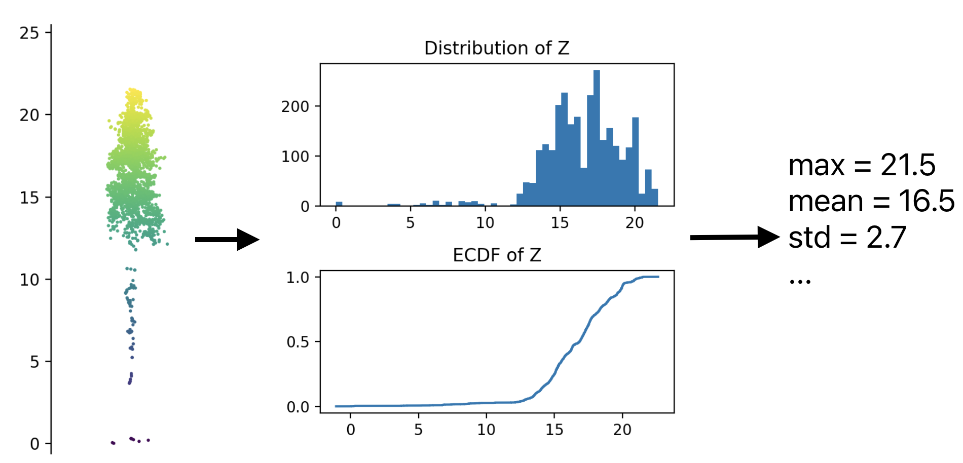
Height distribution features
Maximum height
Average height
Standard deviation of height
Skewness of the height distribution
Kurtosis of the height distribution
Entropy of the height distribution
Proportion of points above the mean
Proportion of points above 2 m
Deciles of height
Cumulative proportion of points at deciles

Slide 9
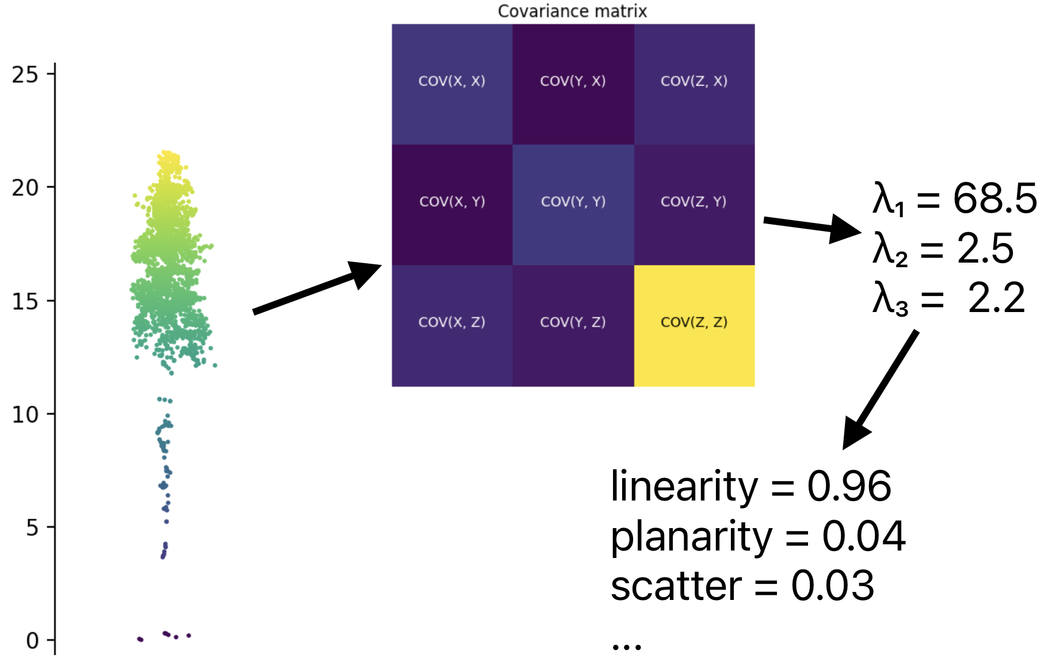
Shape features (based on the eigenvalues of the covariance matrix)
Linearity: (λ₁- λ₂) / λ₁
Planarity: (λ₂- λ₃) / λ₁
Scatter: λ₃ / λ₁
Omnivariance: (λ₁* λ₂ * λ₃)^{1/3}
Eigentropy: -λ₁log(λ₁) - λ₂log(λ₂) - λ₃log(λ₃)
Sum of eigenvalues: λ₁+ λ₂ + λ₃
Curvature: λ₃ / (λ₁+ λ₂ + λ₃)
Chris Lucas et al. 2019. “Identification of Linear Vegetation Elements in a Rural Landscape Using LiDAR Point Clouds.”

Slide 10
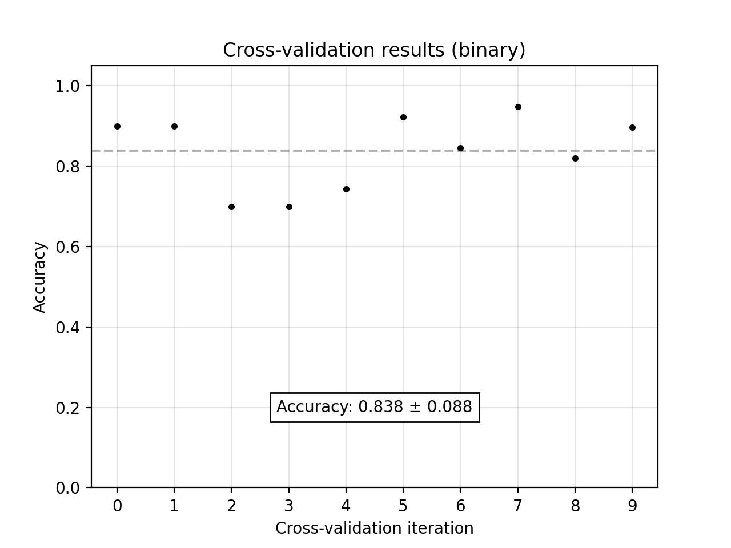
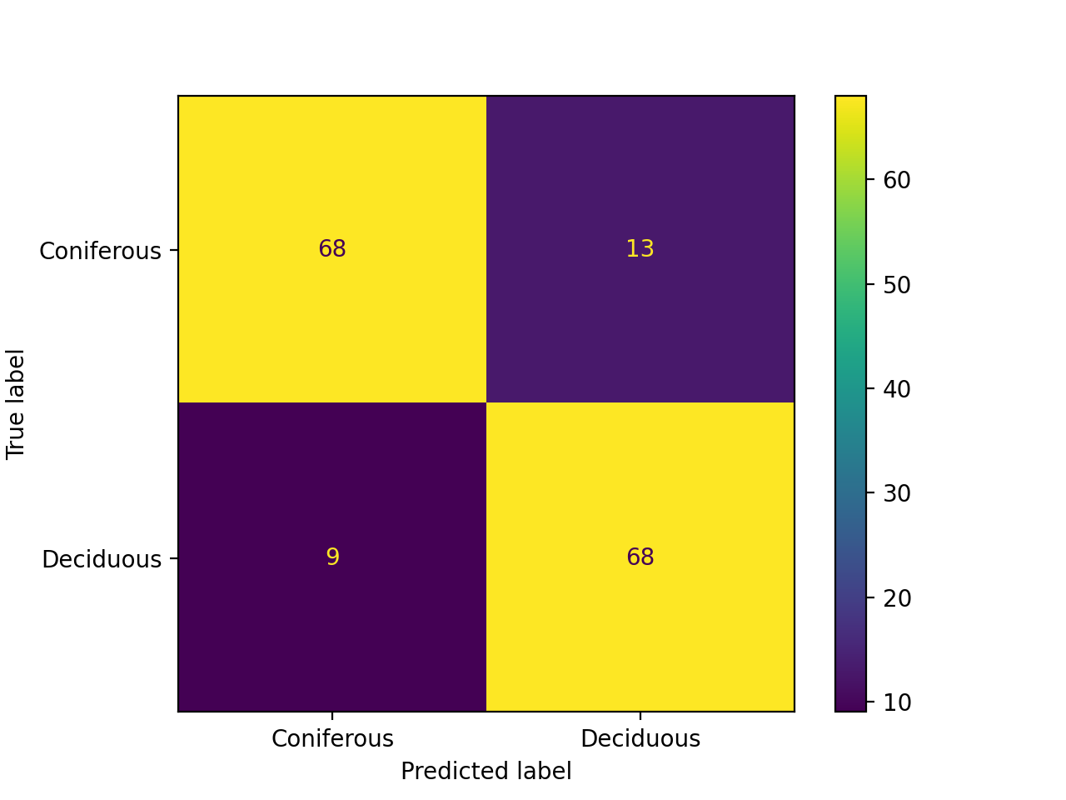
Logistic regression classification results

Slide 11
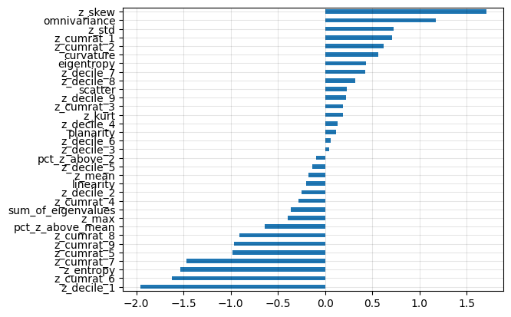
Logistic regression coefficients
Coefficients of logistic regression are treated as proxy for feature importances to see which features have predictive power.

Slide 12
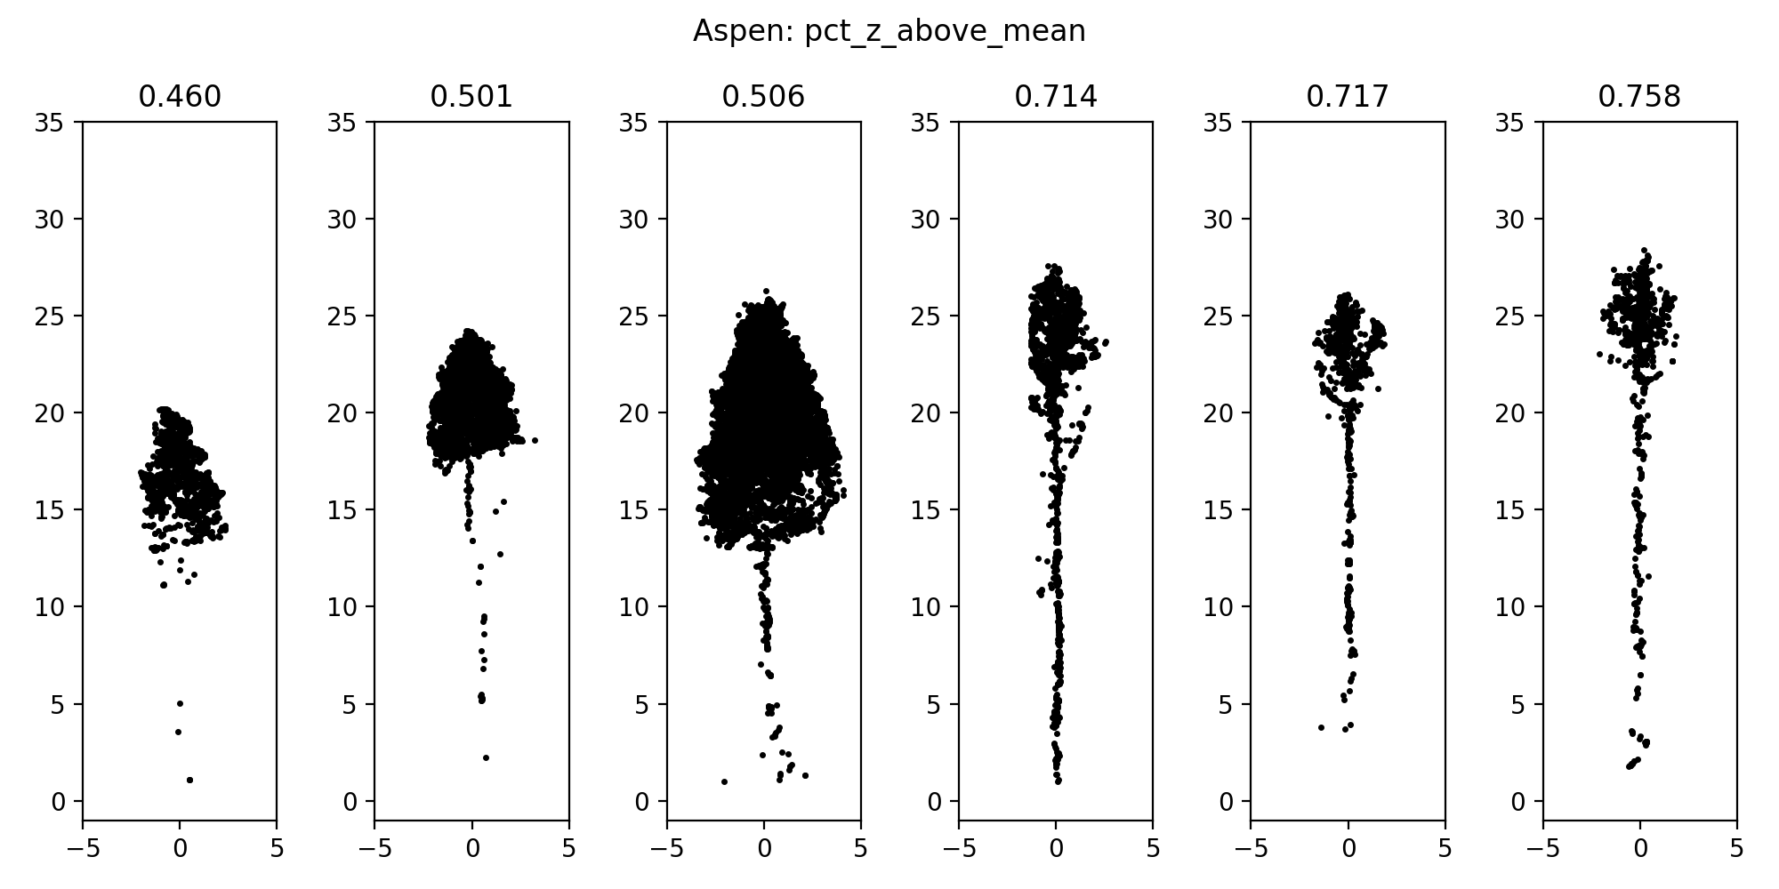

Slide 13
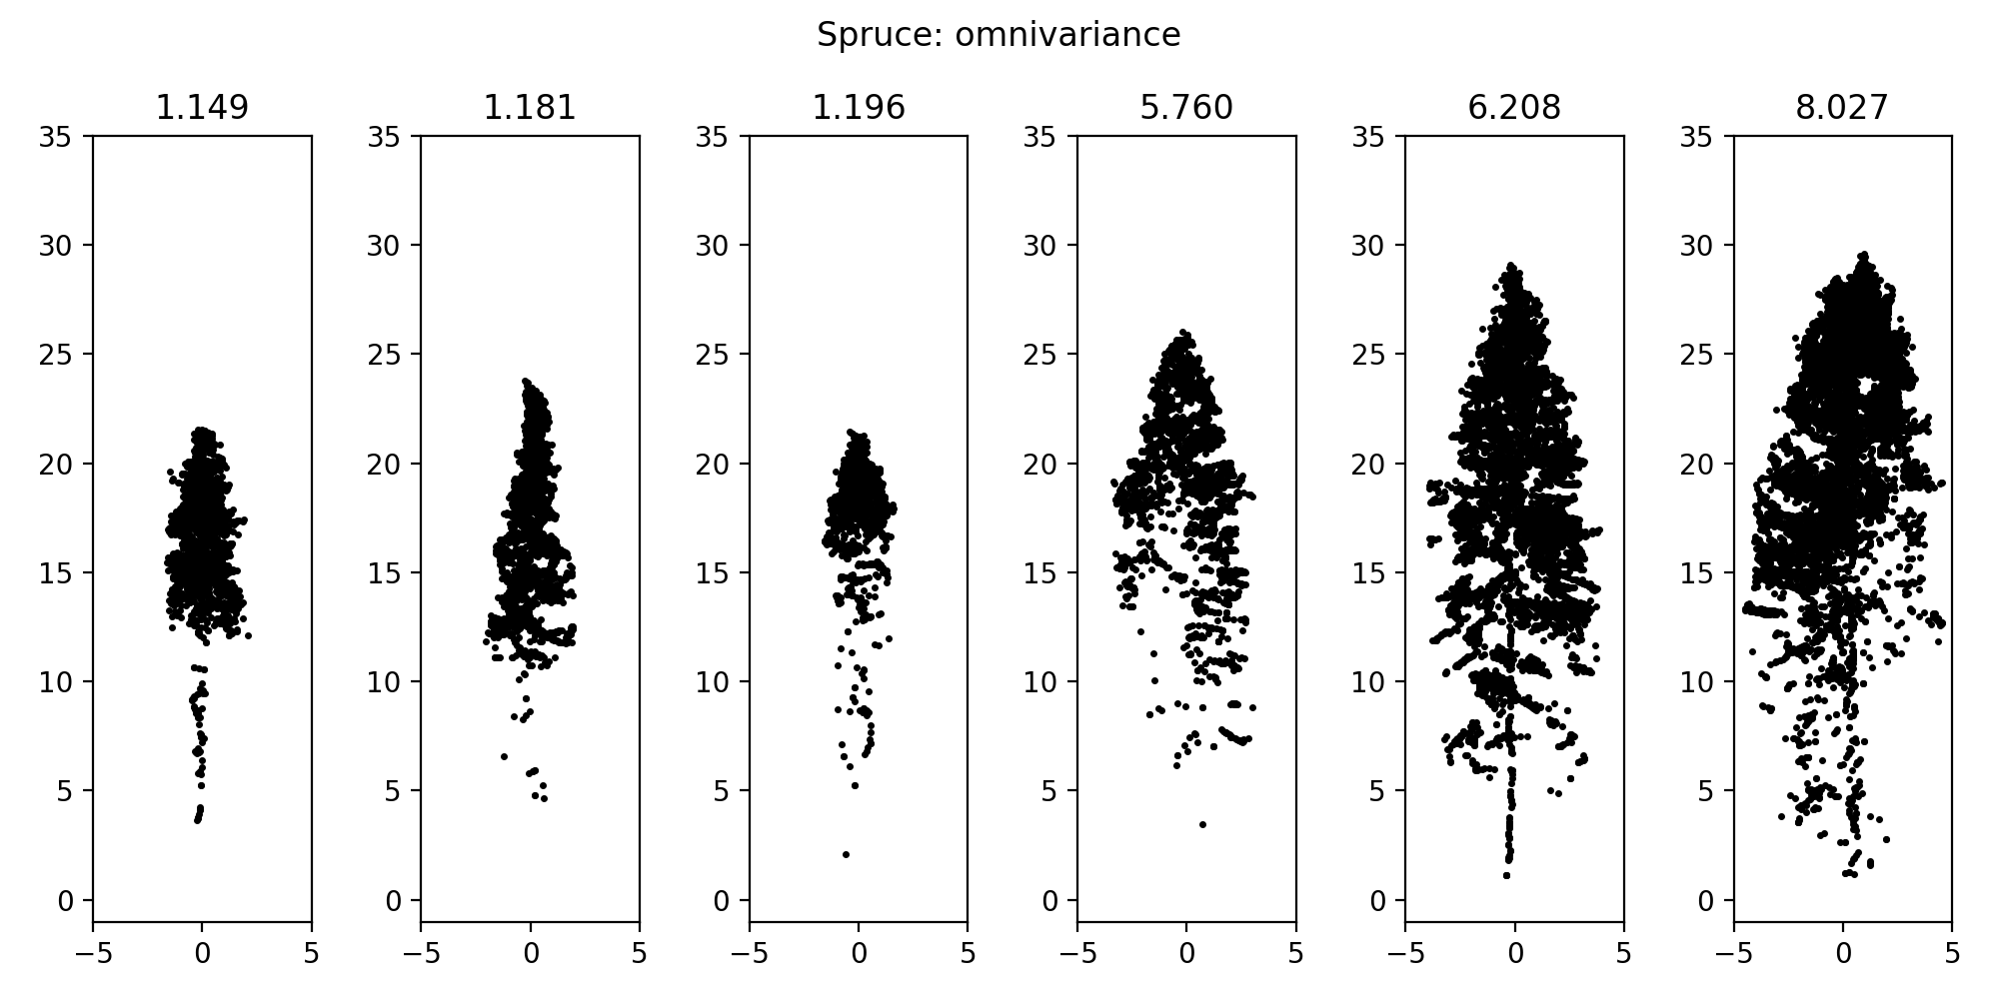

Slide 14
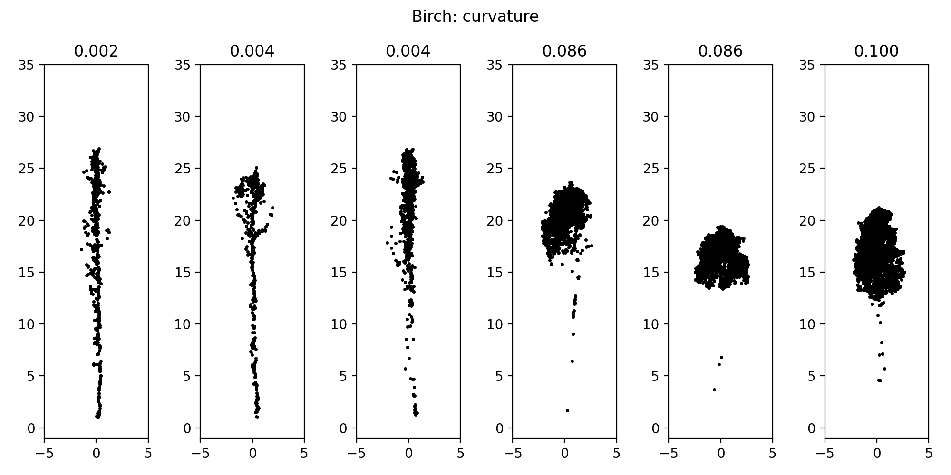

Slide 15
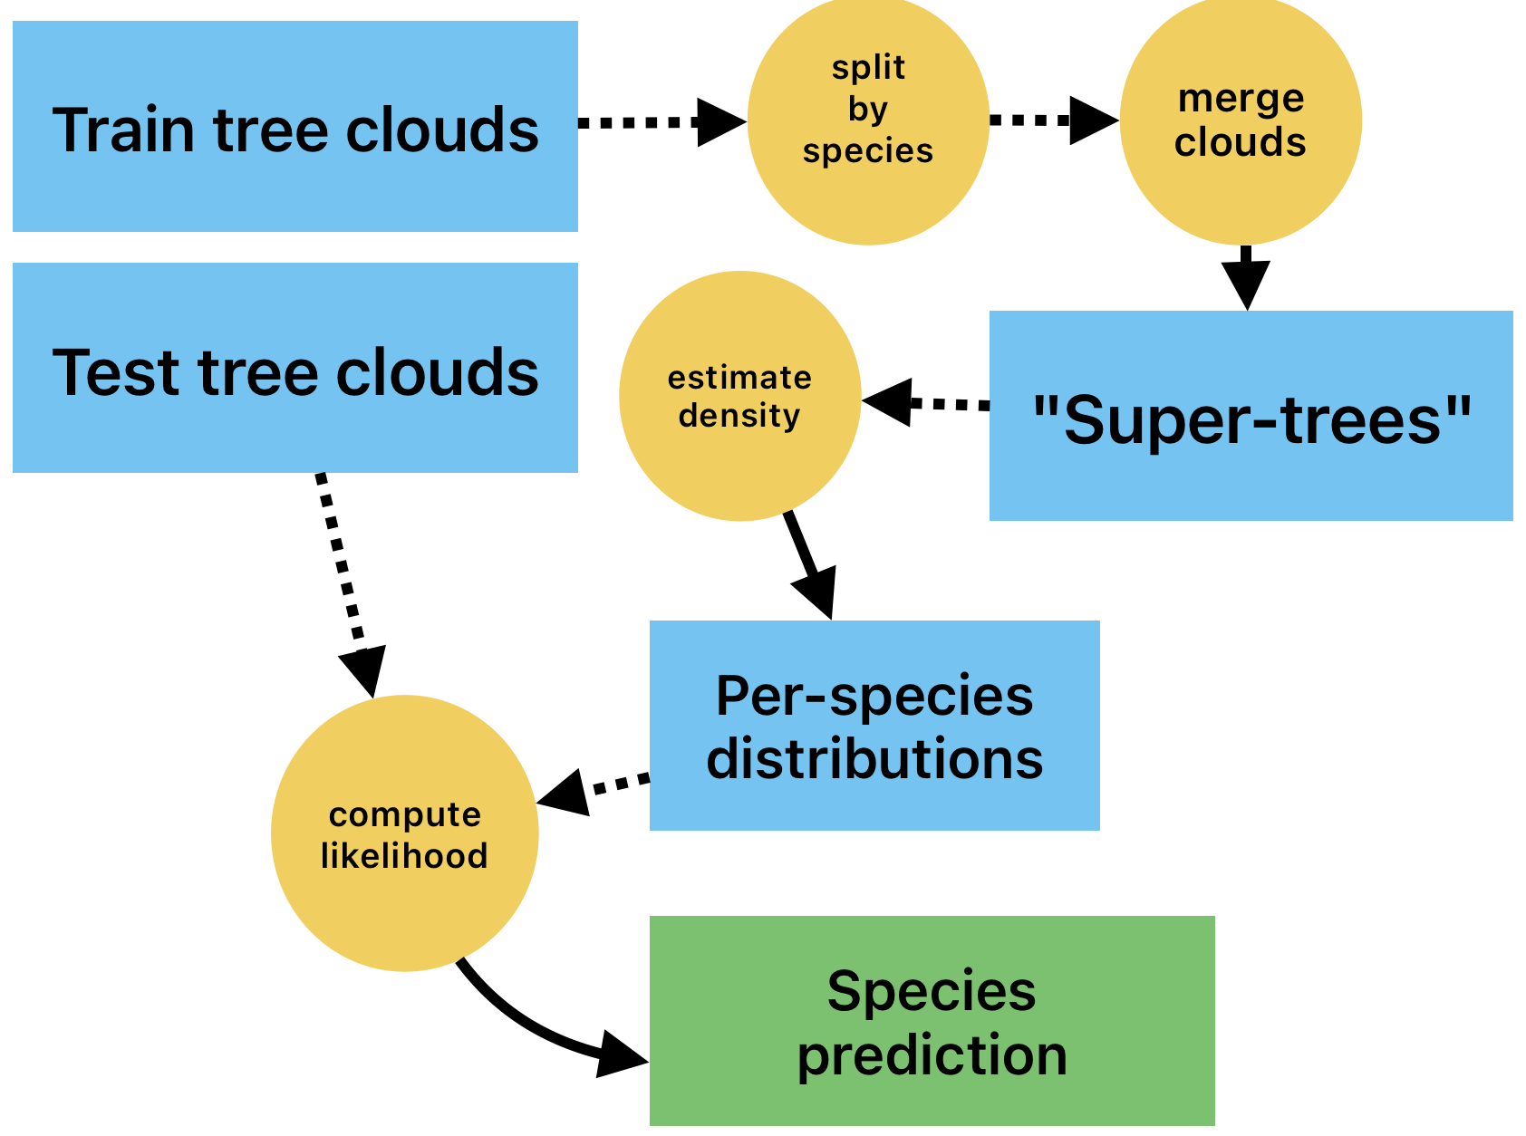
Experiment 2: Tree clouds as 3D distributions
Scale and merge multiple trees of the same species into a “super-tree”, fit a 3D kernel density estimator for each species.
For a tree cloud we need to classify, calculate log-likelihoods for each of the per-species densities.
Classify a tree cloud by assigning the class with the highest likelihood.

Slide 16
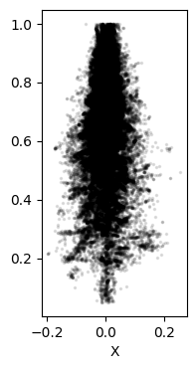
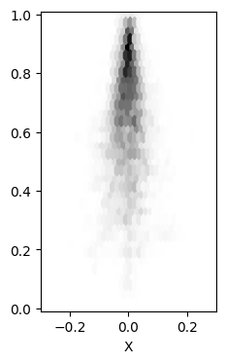
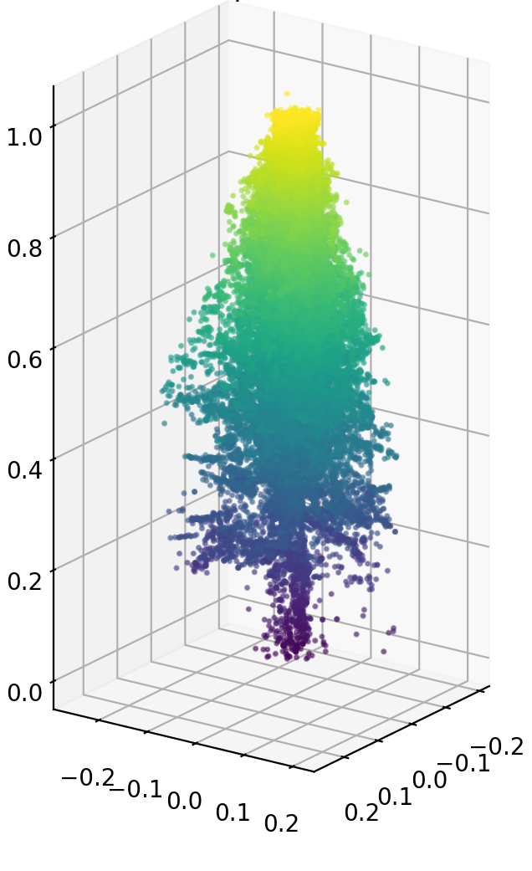

Slide 17
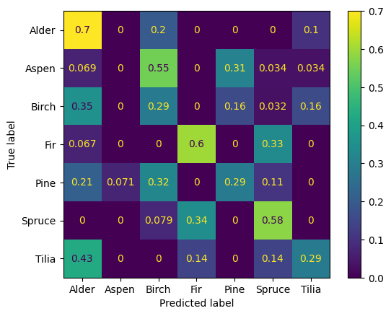
Classification results: multiclass
Overall accuracy is very low.
Better distinguishes among coniferous species than deciduous.
Accuracy: Overall | 36.1%
Accuracy: Deciduous | 23.4%
Accuracy: Coniferous | 48.1%

Slide 18
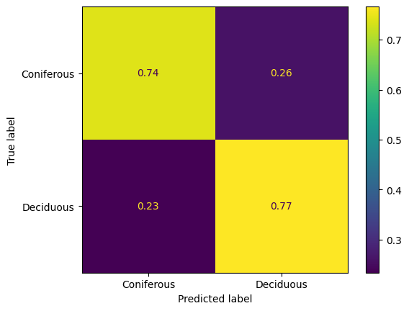
Classification results: reduced to binary
This approach distinguishes between deciduous and coniferous trees reasonably well (still worse than unoptimized LR from experiment 1).
Note: we used the same seven kernel densities, but transformed labels to binary on the fly.
Accuracy: Overall | 75.3%
Accuracy: Deciduous | 76.6%
Accuracy: Coniferous | 74.1%

Slide 19
Final remarks
Experiment 1
An open dataset, potentially useful in many ways.
An easy way to visually understand manual features (and any manual metrics that can be derived from a point cloud).
Experiment 2
Interesting approach, easy to implement, but the results are not good enough.
The inference is very slow.
No real increase in result quality with increasing dataset size.

Slide 20

Thank you!
Follow the link to download the data and accompanying code.
I will be happy to answer any questions!
/iod-ine
kaggle.com/datasets/sentinel3734/uav-point-clouds-of-individual-trees
/in/mr-ivan-dubrovin/

